Slide 1
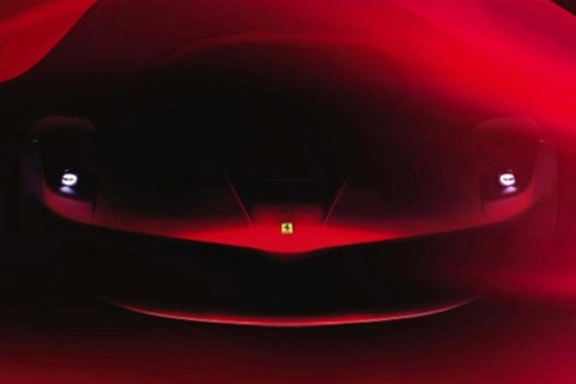
SARDAR PATEL INSTITUTE OF TECHNOLOGY
BRANCH- AUTOMOBILE SUBJECT - EME
Group members Enrollment no.
Guided by:-
Mr. R N.Patel
Anand Shahani 130680102044
Shahnavaz Ghanchi 130680102008
Karan Rupareliya 130680102042
Atishresth Rathode 130680102041
Vikas Singh 130680102046
Mahesh Patel 130680102027

Slide 2
TOPICS
CLUTCH
Purpose of Clutch
Types of Clutches
Contruction of clutch
BRAKES
Introduction
Types of Brakes

Slide 3
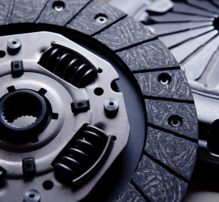
Clutches

Slide 4
Purpose of the Clutch
Allows engine to be disengaged from transmission for shifting gears and coming to a stop
Allows smooth engagement of engine to transmission

Slide 5
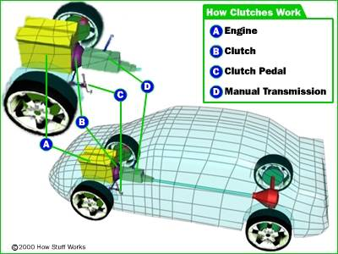
Clutches
Location of the Clutch:-
It is located at middle of the two shaft i.e., the transmission and engine of
the car.

Slide 6
Types of the Clutches:-
Clutches
Mechanical
Pneumatic
Hydraulic
Electromagnetic
Positive contact clutches
Friction clutches
Jaw Clutch
Toothed Clutch
Disc Clutch
Cone Clutch
Centrifugal Clutch

Slide 7
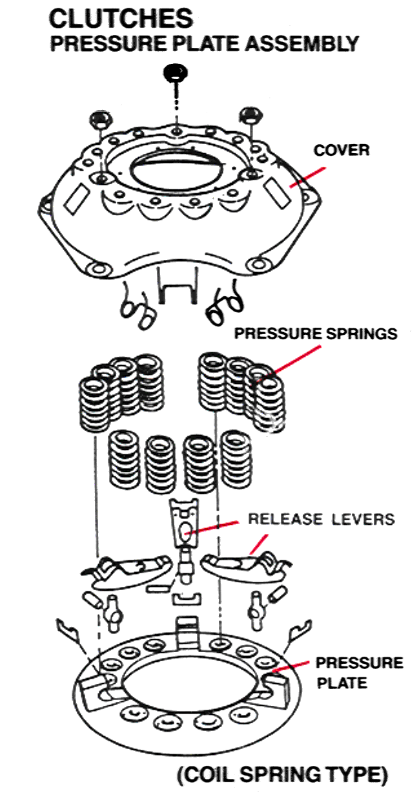
Construction of the Clutch

Slide 8
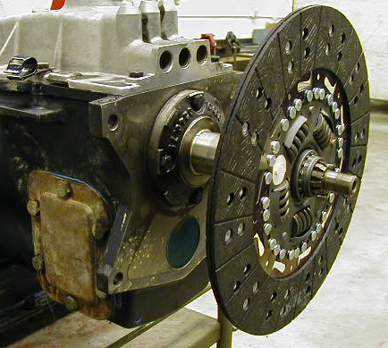
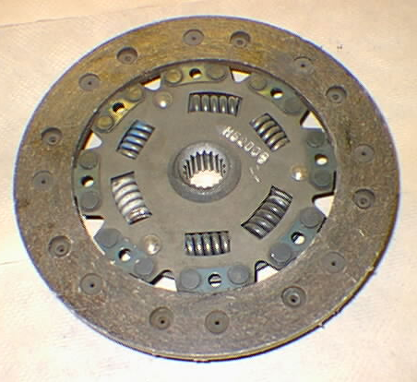
Clutches
Splines to input shaft
Of transmission
44-3 Construction of the Clutch
Clutch Disk or
Friction Disk

Slide 9
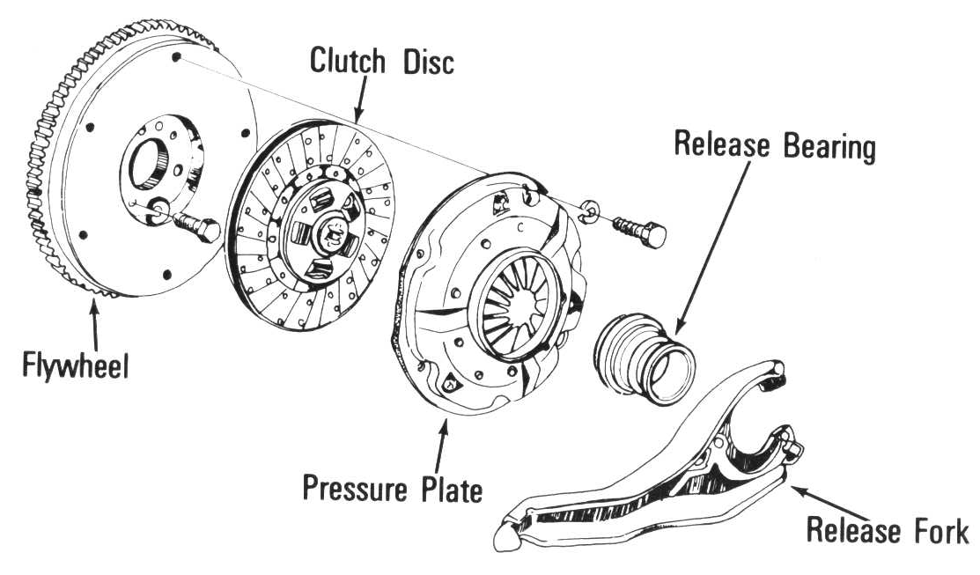
Clutches
Pilot bushing or bearing in center
of flywheel or crankshaft, supports
the end of input shaft
(friction disk) splined to transmission
Input shaft
(throw-out bearing
T/O bearing) allows
to push on rotating
clutch fingers
Bolted to Crank
Bolted to flywheel - Applies
the spring force to clamp the
friction disk to the flywheel
(clutch fork) pushes
T/O bearing to release
rotating clutch

Slide 10
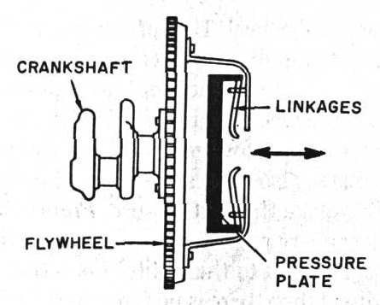
Pressure Plate
Releases friction disk
from flywheel
Moves pressure
Plate right
Pivots
T/O bearing

Slide 11
Clutch terms
Clutch disengaged
Clutch pedal is in or down
Clutch engaged
Clutch pedal is out or up
What would it mean if someone said the clutch pedal
Is engaged?
Make sure you know if you are talking about
the clutch or the clutch pedal !!!

Slide 12
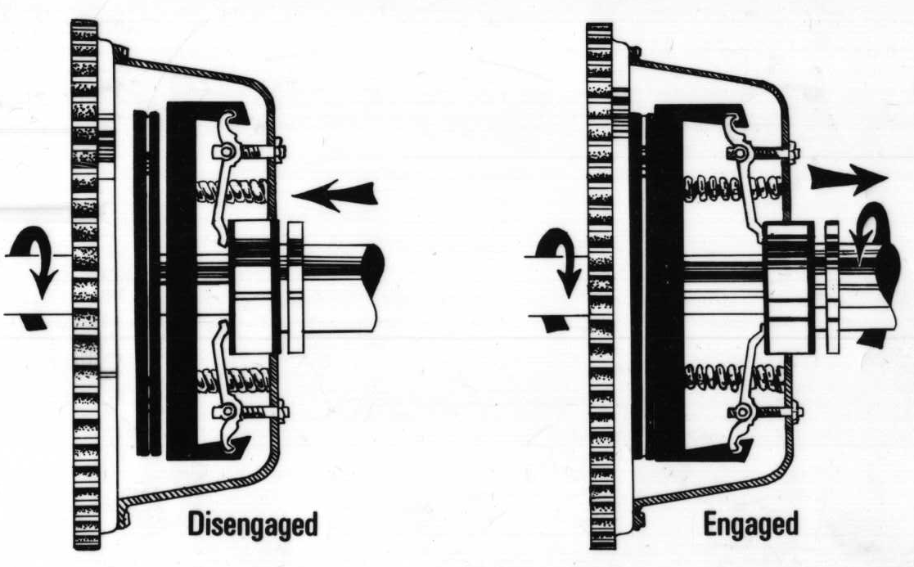
Clutches

Slide 13
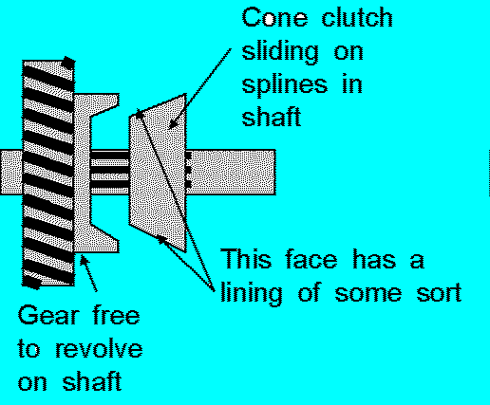
CONE CLUTCH
As the name implies, a cone clutch has conical friction surfaces. The cone's taper means that a given amount of movement of the actuator makes the surfaces approach (or recede) much more slowly than in a disc clutch.
As well, a given amount of actuating force creates more pressure on the mating surfaces. The best known example of a cone clutch is a synchronizer ring in a manual transmission.
The synchronizer ring is responsible for
"synchronizing" the speeds of the shift
hub and the gear wheel to ensure a
smooth gear change.

Slide 14
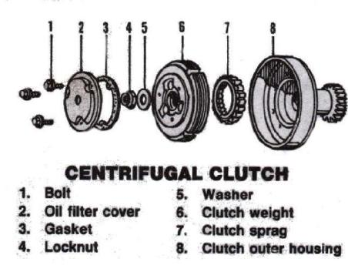
CENTRIFUGAL CLUTCH
A centrifugal clutch is used in some vehicles and also in other applications where the speed of the engine defines the state of the clutch, for example, in a chainsaw. This clutch system employs centrifugal force to automatically engage the clutch when the engine rpm rises above a threshold and to automatically disengage the clutch when the engine rpm falls low enough.
The system involves a clutch shoe or shoes attached to the driven shaft, rotating inside a clutch bell attached to the output shaft. The shoe(s) are held inwards by springs until centrifugal force overcomes the spring tension and the shoe(s) make contact with the bell, driving the output. In the case of a chainsaw this allows the chain to remain stationary whilst the engine is idling; once the throttle is pressed and the engine speed rises, the centrifugal clutch engages and the cutting chain moves.

Slide 15
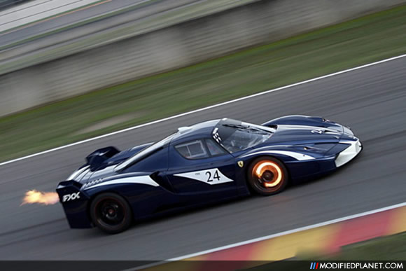
BRAKES

Slide 16
Introduction
A brake is a mechanical device which inhibits motion.
Brakes are generally applied to rotating axles or wheels, but may also take other forms such as the surface of a moving fluid (flaps deployed into water or air). Some vehicles use a combination of braking mechanisms,

Slide 17
TYPE
Frictional brakes
Band brakes
Hand brakes

Slide 18
FRICTIONAL BRAKE
Friction (pad/shoe) brakes are often rotating devices with a stationary pad and a rotating wear surface.
Common configurations include shoes that contract to rub on the outside of a rotating drum, such as a band brake a rotating drum with shoes that expand to rub the inside of a drum, commonly called a "drum brake", although other drum configurations are possible; and pads that pinch a rotating disc, commonly called a "disc brake".

Slide 19
Band brakes
A band brake is a primary or secondary brake, consisting of a band of friction material that tightens concentrically around a cylindrical piece of equipment to either prevent it from rotating (a static or "holding" brake), or to slow it (a dynamic brake). This application is common on winch drums and chain saws and is also used for some bicycle brakes.
A former application was the locking of gear rings in epicyclical gearing. In modern automatic transmissions this task has been taken over entirely by multiple-plate clutches or multiple-plate brakes.

Slide 20
Hand Brake
In cars, the parking brake, also called hand brake, emergency brake, or e-brake, is a latching brake usually used to keep the vehicle stationary. It is sometimes also used to prevent a vehicle from rolling when the operator needs both feet to operate the clutch and throttle pedals.
Automobile hand brakes usually consist of a cable directly connected to the brake mechanism on one end and to a lever or foot pedal at the driver's position. The mechanism is often a hand-operated lever (hence the hand brake name), on the floor on either side of the driver, or a pull handle located below and near the steering wheel column, or a (foot-operated) pedal located far apart from the other pedals.

Slide 21
Brake boost
Most modern vehicles use a vacuum assisted brake system that greatly increases the force applied to the vehicle's brakes by its operator. This additional force is supplied by the manifold vacuum generated by air flow being obstructed by the throttle on a running engine. This force is greatly reduced when the engine is running at fully open throttle, as the difference between ambient air pressure and manifold (absolute) air pressure is reduced, and therefore available vacuum is diminished. However, brakes are rarely applied at full throttle; the driver takes the right foot off the gas pedal and moves it to the brake pedal - unless left-foot braking is used.

Slide 22
WHAT HAPPENS WHEN BRAKE FAILURE OCCURS?

Slide 23
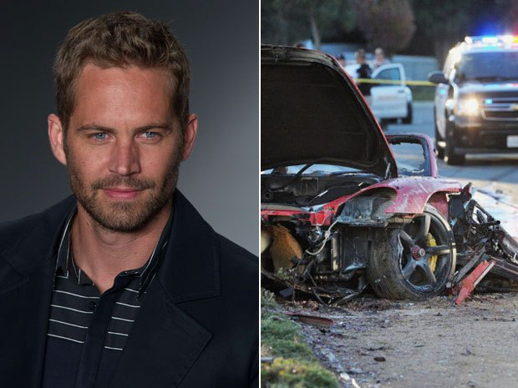

Slide 24
Paul walker died in a high speed crash

Slide 25
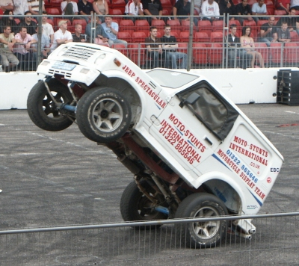
Thank you

