Slide 1
SARDAR PATEL INSTITUTE OF
TECHNOLOGY, PILUDARA
Prepaid by :
Karan H. Rupareliya (130680102042)
Prajesh Aakhaja (130680102001)
Pintu ( 130680102043)
(Branch: Automobile Engineering)
Guided by :
Vaishali D.Patel

Slide 2
MCB
(Miniature Circuit Breaker)

Slide 3
Topics :
Introduction
Principle of Operation
Construction
Classification
Application

Slide 4
What is MCB?
A Miniature Circuit Breaker is an Electromechanical Device which operates and disconnects the circuit when the current reaches a pre determined value (High current).
An MCB is a replacement or most modern substitute for a conventinal rewirable fuse with most accurate efficient system in overload and short circuit.

Slide 5
Principle of Operation
MCB is a device which operate on the two principles for the protection against overload and short circuit :
1) Thermal for normal overload
Protection
2) Magnetic for short circuit protection

Slide 6
1) Thermal for normal overload Protection :
The thermal operation of miniature
circuit breaker is achieved with a bimetallic strip whenever continuous over current flows through MCB, the bimetallic strip is heated and deflects by bending.
This deflection of bimetallic strip releases mechanical latch.
As this mechanical latch is attached with operating mechanism, it causes to open the miniature circuit breaker contacts.
But during short circuit condition, sudden rising of electric current.

Slide 7
Miniature circuit breaker Construction :
Miniature circuit breaker construction is very simple, robust and maintenance free. Generally an MCB is not repaired or maintained, it just replaced by new one when required. A miniature circuit breaker has normally three main constructional parts. These are :
1) Frame of Miniature Circuit Breaker
2) Operating Mechanism of Miniature
Circuit Breaker
3) Trip Unit of Miniature Circuit Breaker

Slide 8
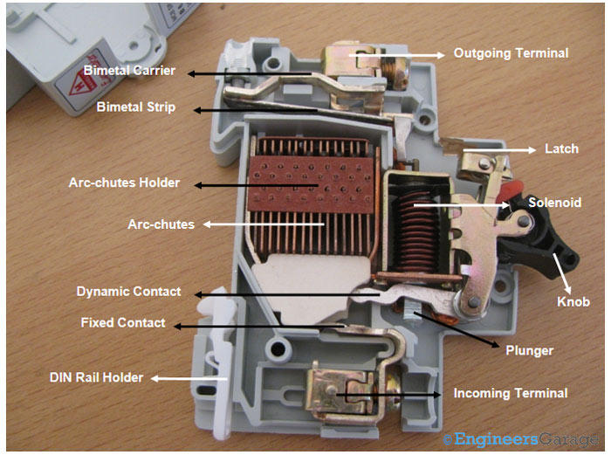
1) Frame of Miniature Circuit Breaker :
The Frame of Miniature Circuit Breaker is a molded case.
This is a rigid, strong, insulated housing in which the other components are mounted.

Slide 9
2) Operating Mechanism of Miniature Circuit Breaker :
The Operating Mechanism of Miniature Circuit Breaker provides the means of manual opening and closing operation of miniature circuit breaker.
It has three-positions "ON," "OFF," and "TRIPPED". The external switching latch can be in the "TRIPPED" position, if the MCB is tripped due to over-current.
When manually switch off the MCB, the switching latch will be in "OFF" position.
In close condition of MCB, the switch is positioned at "ON".

Slide 10
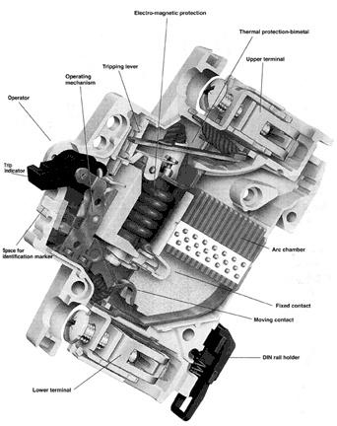
3) Trip Unit of Miniature Circuit Breaker :
The Trip Unit is the main part, responsible for proper working of miniature circuit breaker.
Two main types of trip mechanism are provided in MCB.
A bimetal provides protection against over load current and an electromagnet provides protection against short-circuit current.

Slide 11
Classification :
MCB are classified into two series :
1) L series MCB for lighting circuits :
Suitable for resistive load installation with low and steady currents like heaters, ovens, geysers, GLS lamps, electric irons, etc.
The L series MCBS are also used protection of distribution equipment like wires, cables, metering equipment etc.

Slide 12
2) G- series MCB for motor circuits :
It is suitable for use in installation with high inrush current peaks which require closer overload protection.
These include inductive loads such as motors, air conditions, transformers, halogen lamp, fluorescent lamps, sodium vapour lamps , machine tools etc.

Slide 13
Application Of MCB :
MCB are required in homes, offices, shops distribution boards for protection of individual circuit and complete wiring system in that building through main circuits.
MCB are sightly more expensive than fuses but this is offset by the fact that no cost is involved in resetting them after operation and it is very quick & simple process.
They are being used extensively these days and are virtually replacing the traditional rewirable fuses.

Slide 14
References
U.A PATEL (2013-2014)
MAHAJAN (2013-2014)
BOOKS INDIA PUBLICATION (2013-2014)

Slide 15
THANK YOU…

