Slide 1
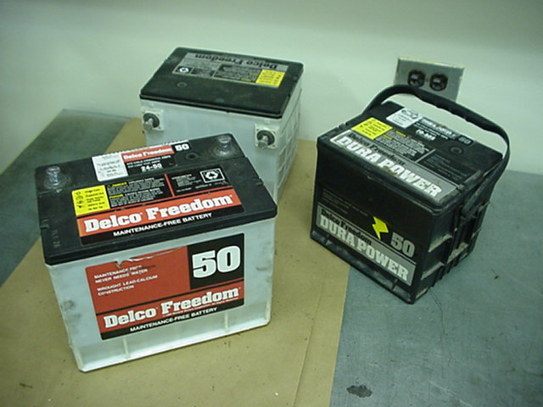
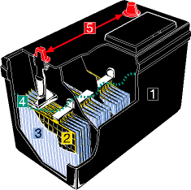
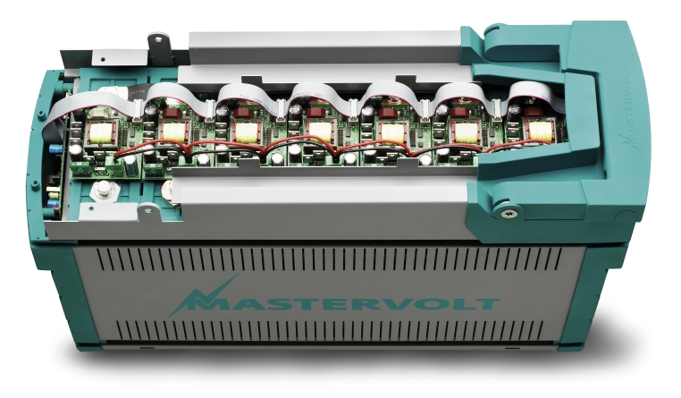
Batteries

Slide 2
  CLASSES OF BATTERIES
PRIMARY CELLS
SECONDARY CELLS

Slide 3
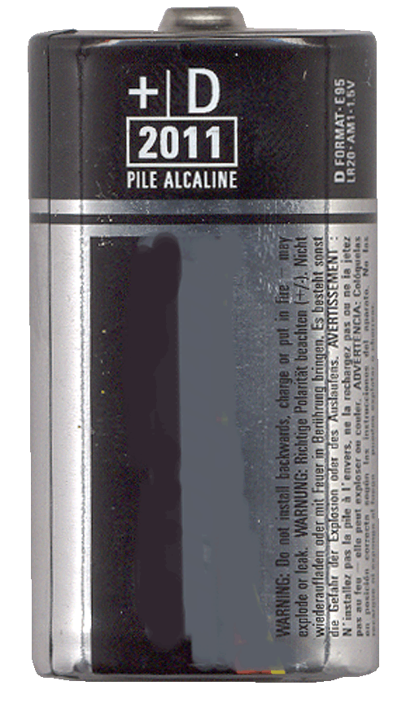
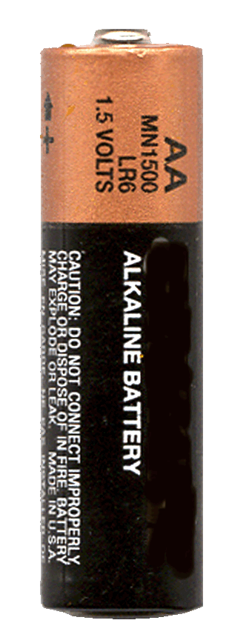
PRIMARY CELLS
CANNOT BE RECHARGED
CHEMICAL PROCESS NOT REVERSABLE
ZINC CARBON (1.5V)
ALKALINE (1.5V)

Slide 4
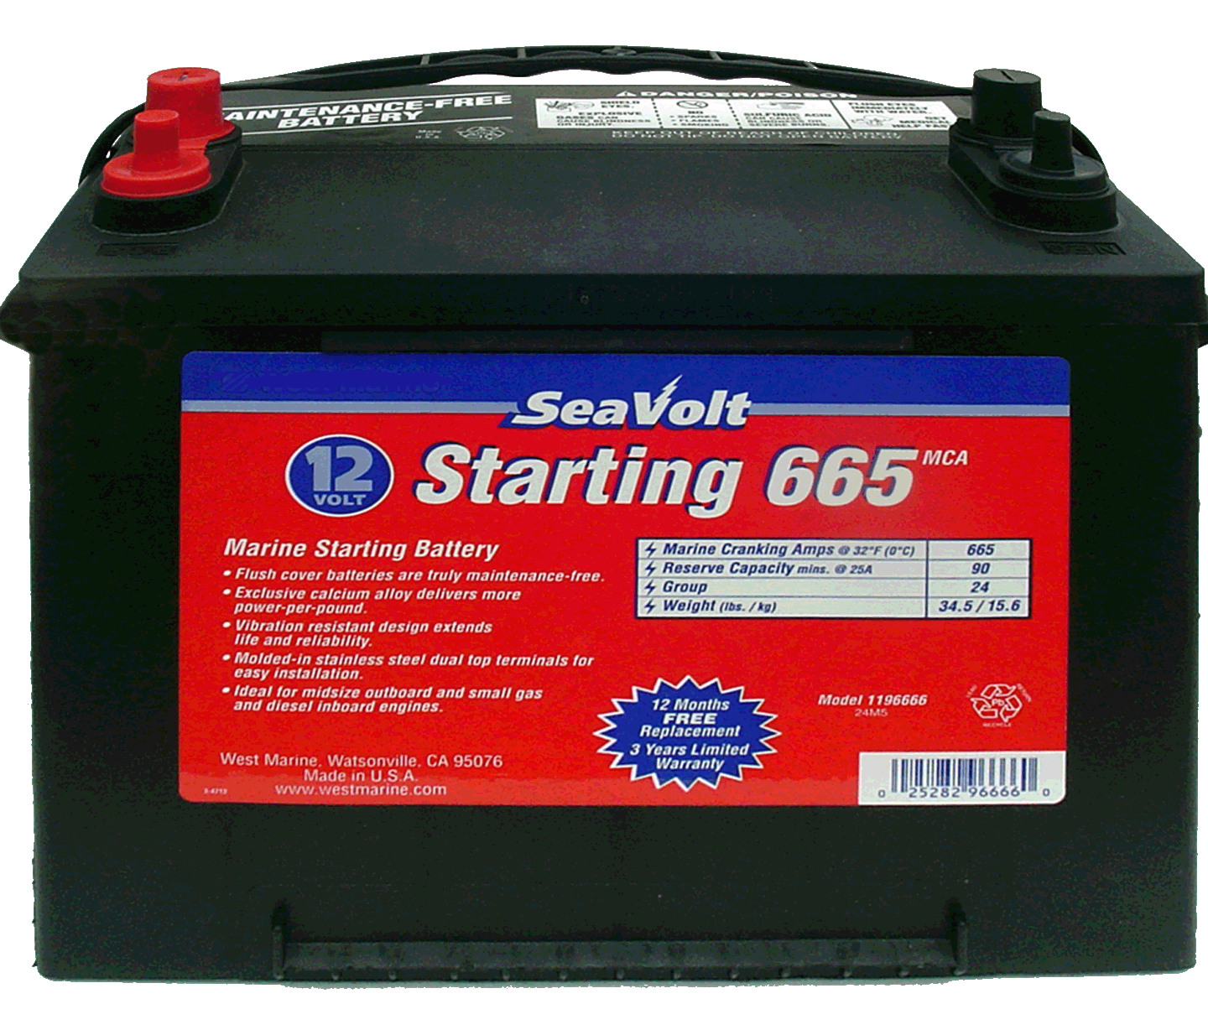
SECONDARY CELLS
CAN BE RECHARGED
CHEMICAL REACTION REVERSABLE
LEAD ACID (2.0V)
NICKEL - CADMIUM (1.2V)
NICKEL - METAL HYDRIDE (1.2V)
LITHIUM – ION (3.3V)

Slide 5
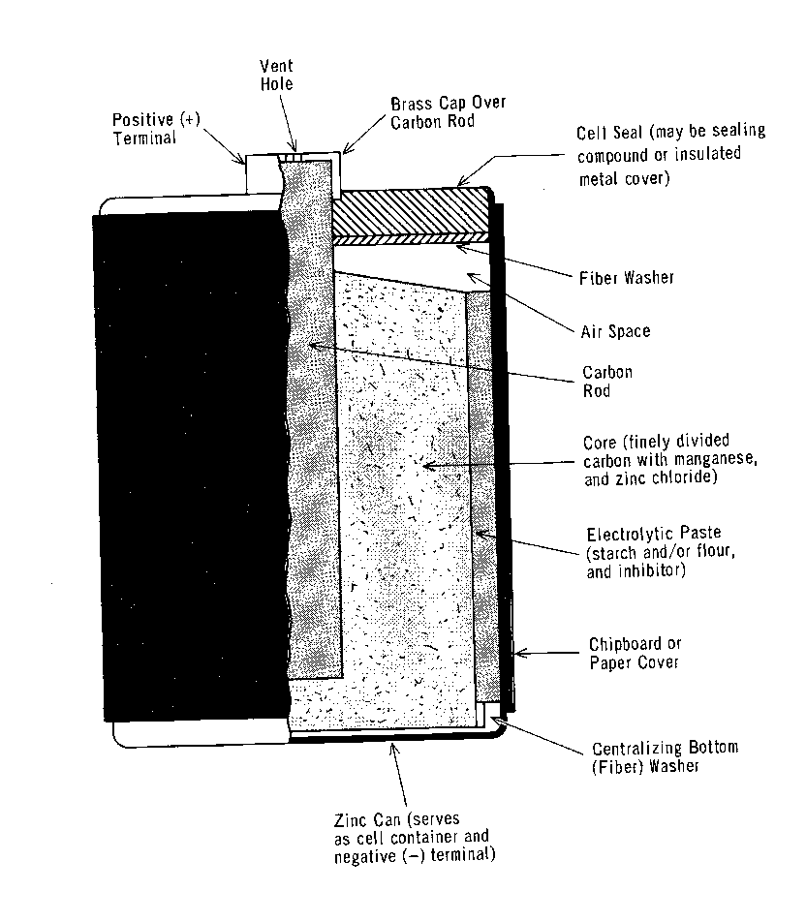
DRY CELL
Uses An electrolytic paste.
The electrolytic paste reacts with the electrodes to produce a negative charge on one electrode and a positive charge on the other.
The difference of potential between the two electrodes is the output voltage.

Slide 6
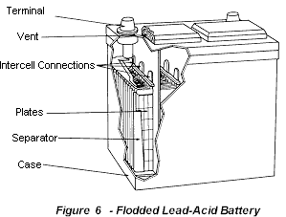
Lead Acid Battery
Electrolyte for the most part distilled (pure) water, with some sulfuric acid mixed with the water.
Electrodes must be of dissimilar metals.
An active electrolyte.

Slide 7
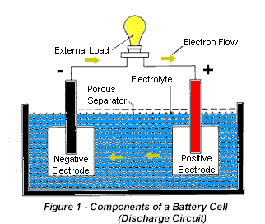
Cells
Positive electrode
Negative electrode
Electrolyte
Separator

Slide 8
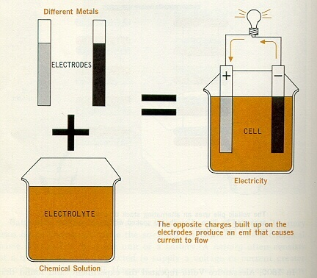
The basic primary wet cell
The metals in a cell are called the electrodes, and the chemical solution is called the electrolyte.
The electrolyte reacts oppositely with the two different electrodes
It causes one electrode to lose electrons and develop a positive charge; and it causes one other electrode to build a surplus of electrons and develop a negative charge.
The difference in potential between the two electrode charges is the cell voltage.

Slide 9
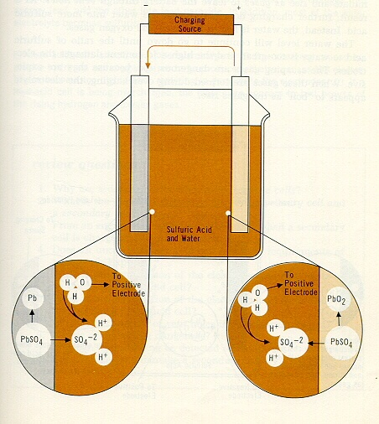
The Electrolyte
When charging first started, electrolysis broke down each water molecule (H₂O) into two hydrogen ions (H⁺) and one oxygen ion (O⁻²).
The positive hydrogen ions attracted negative sulfate ions (SO₄⁻²) from each electrode.
These combinations produce H₂SO₄, which is sulfuric acid.

Slide 10
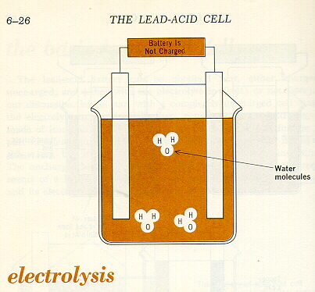
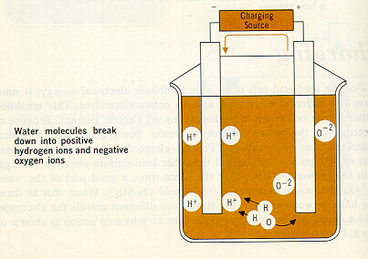
Electrolysis
The producing of chemical changes by passage of an electric current through an electrolyte.

Slide 11
COMPOSITION OF A BATTERY
The Lead Acid battery is made up of seperator plates, lead plates, and lead oxide plates (various other elements are used to change density, hardness, porosity, etc.) with a 35% sulphuric acid and 65% water solution. This solution is called electrolyte which causes a chemical reaction that produce electrons.
When a battery discharges the electrolyte dilutes and the sulphur deposits on the lead plates.
When the battery is recharged the process reverses and the sulphur dissolves into the electrolyte.

Slide 12
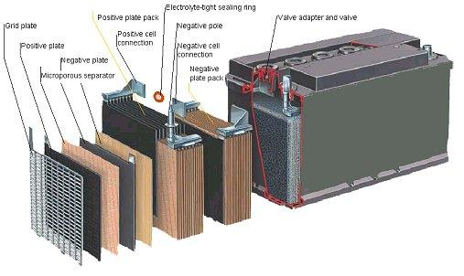
BATTERY CROSS SECTION

Slide 13
TECHNOLOGIES
Flooded
  Sometimes called “flooded” or “free-vented”
Gelled Electrolyte (Gel)
  Also called Valve-Regulated Lead Acid (VRLA)
Absorbed Glass Mat (AGM)
  Also called Valve-Regulated Lead Acid (VRLA)

Slide 14
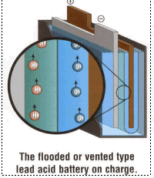
FLOODED VENTED

Slide 15
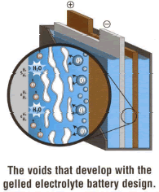
GEL

Slide 16
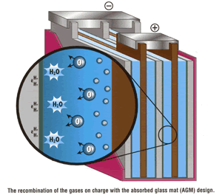
AGM

