Slide 1


Slide 2
PREPARED BY :-
1) BAPODRA ANAND
2) CHUDASAMA MAYURI
3) GONDALIYA POOJA
4) KAMDIYA POOJA
5) MARDIYA UTSAV
6) DESAI NIKUNJ
7) BHESDADIYA DIXITA

Slide 3
Introduction to clutches

Slide 4
Introduction :
Clutch is a machine member which engage and disengage
the driving shaft to driven shaft.
The cone clutch is an axially actuated clutch which is able to transmit a relatively high torque for its size compared to a single disk plate clutch of the same dimensions.
This results from the wedging action and increased friction area. Cone clutches are not used widely now and are generally used for low peripheral speed applications.
The characteristic use of a clutch is to connect two shafts rotating at different speed sand bring the output shaft up to the speed of the input shaft smoothly and gradually.

Slide 5
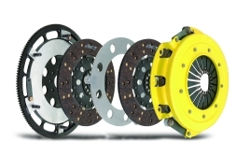
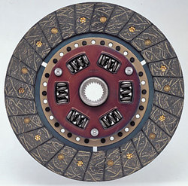
Types Of Clutches :-
Clutch is classified into two categories :
(1) Positive clutches:
(i) jaw clutch.
(2) Friction clutches:
(i) Disk clutch.
(ii) Cone clutch.
(iii) Centrifugal clutch.

Slide 6
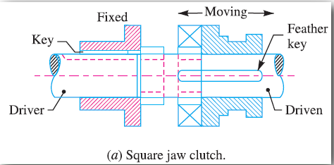
Positive Clutches :-
Positive clutch is used when a positive drive is require.
The simplest type of a positive clutch is Jaw clutch.The jaw clutch is permits one shaft to drive another shaft through direct contact of jaw.
It consist of two halves, one of which permanently joined with driving shaft. The another half of clutch is moveable and it is free to slide axially on the driving shaft.

Slide 7
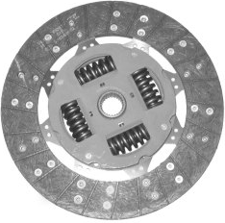

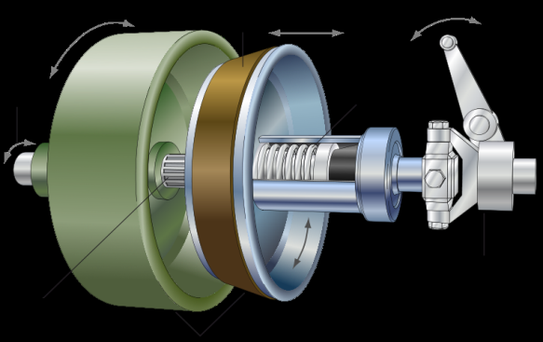

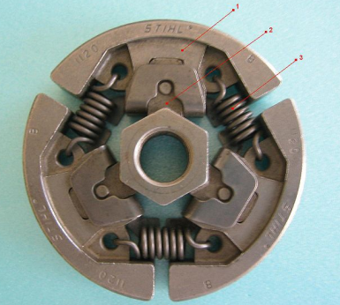

Friction Clutches :-
Friction clutches are classified below:
[1] Disk clutch.
(I) Single disk clutch.
(II) Multiple disk clutch.
[2] Cone clutch.
[3] centrifugal clutch.

Slide 8
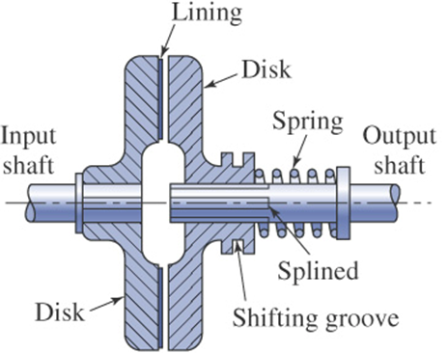
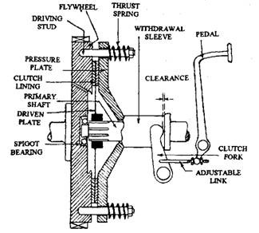

Single Disc Clutch :-
A Single disk clutch , consists of a clutch plate whose both sides are faced with frictional material.
The friction disc is arranged between the machined surfaces of the flywheel and the pressure plate when the pressure plate is bolted to the outer edge of the flywheel face.
Both the pressure plate and flywheel
rotate with driving shaft. The pressure
plate pushes the clutch plate towards
the flywheel by a set of springs which
are arranged radially inside the body.
When the clutch pedal is depressed,
the movement is transferred through the
operating mechanism, to the operating fork
and the release bearing.

Slide 9
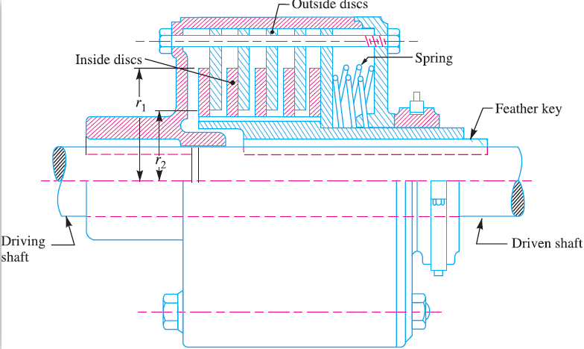

Multiple Disc Clutch:-
A multiple disk clutch ,as shown in figure. It may be used when a large torque can be transmitted.
There are more than one friction disc arrange parallelly on the driving shaft.
The inside discs are joined with driven shaft to permit axial motion. The outside discs are
joined with driving shaft.
When force on pedal is remove,
then discs contact with friction
ring and the torque is
transmitted between
driving shaft and driven shaft.

Slide 10
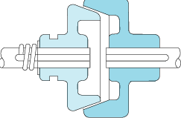

Cone Clutch :-
A cone clutch has a same purpose as a disk or plate clutch. However, instead of mating two spinning disks, the cone clutch uses two conical surfaces to transmit torque by friction.
The cone clutch transfers a higher torque than plate or disk clutches action and increased surface area.
Cone clutches are generally now only
used in low peripheral speed
applications although they were
once common in automobiles and
other combustion engine
transmissions.

Slide 11
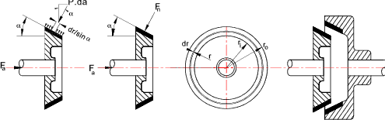
The cone clutch consists of one pair of friction surface only.
The driven member of the clutch arranged on the driven shaft . As per order to engage the clutch and two conical frictional surfaces are comes in contact.
Due to frictional resistance set up at this contact surface, the torque is transmitted from driving shaft to driven shaft.
Pressure applied by a driving member on outer surface of the driven member by means of friction.

Slide 12
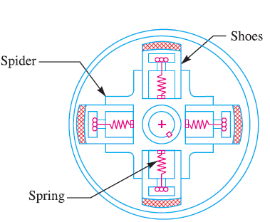

Centrifugal Clutch :-
The most common centrifugal clutches have friction pads (shoes) which connect to the inside of the housing. shoe connects to a various amount of extension springs on the center shaft.
centrifugal clutch is a clutch that uses centrifugal force to connect two concentric shafts, with the driving shaft nested inside the driven shaft.
The increase of speed causes the
press harder and more torque
can be transmitted.
A centrifugal clutch is used on
most racing go-karts.

Slide 13
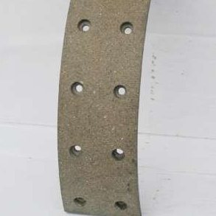

Material used in clutch :-
Various materials have been used for the disc friction facings, including asbestos in the past.
Frictional material used in clutch should have a high and uniform coefficient of friction.
Modern clutches typically use an Organic_compound. organic resin with copper wire facing or a ceramic material.
Ceramic materials are typically used
in heavy applications such as trucks
carrying large loads or racing though
the harder ceramic materials increase
flywheel and pressure plate wear.

Slide 14
Thank You
GUIDE BY :- Prof. Ankit v. Sata

